Slide 1
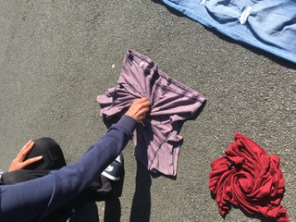
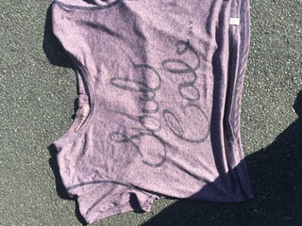
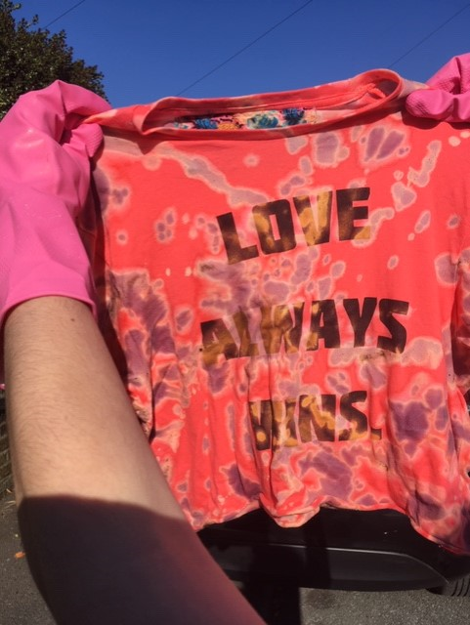
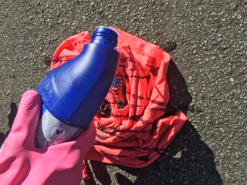
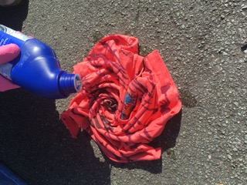
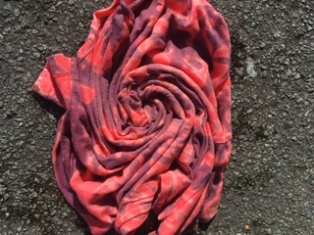
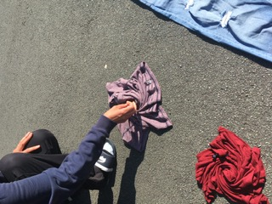
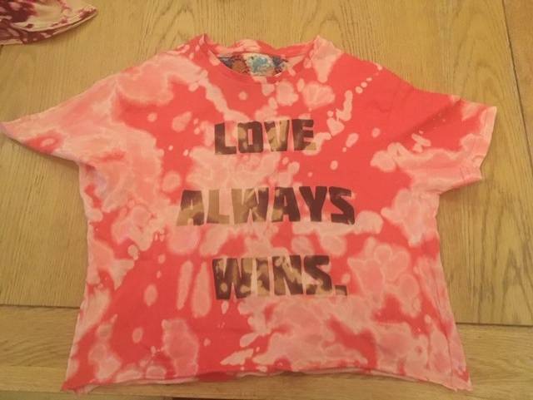
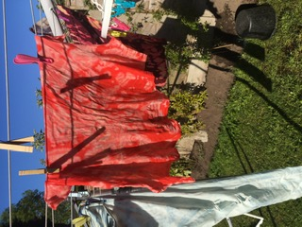
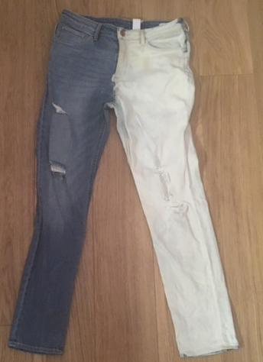
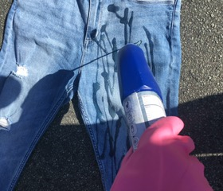
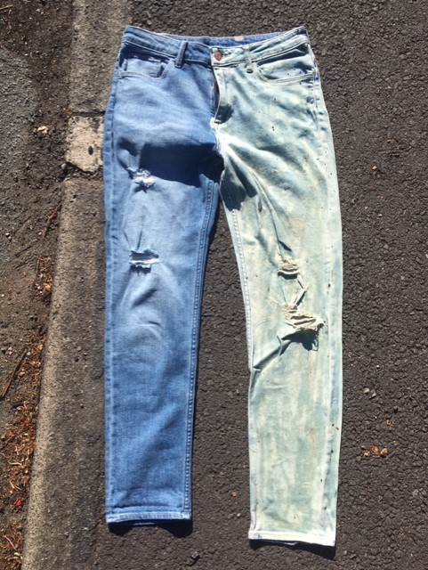
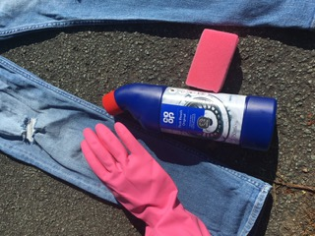
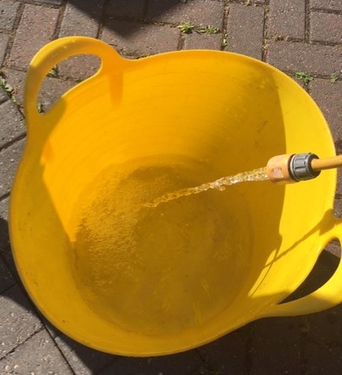
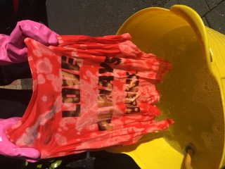
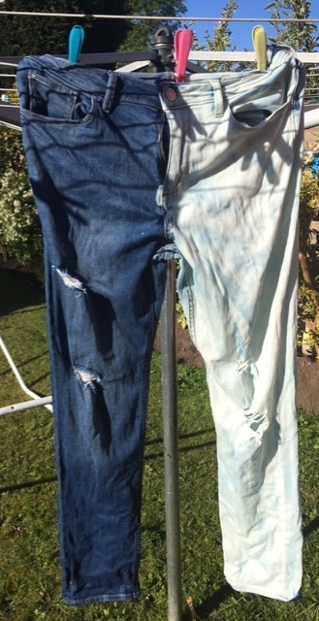
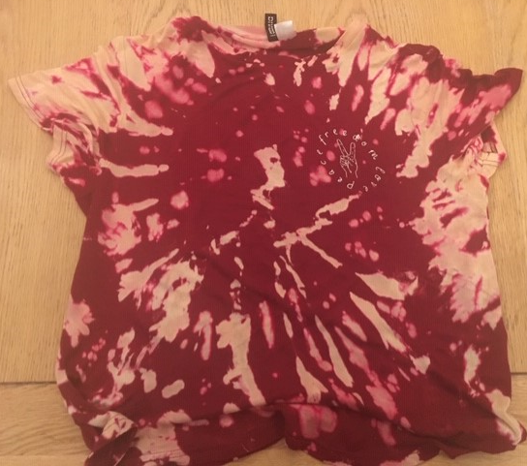
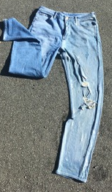
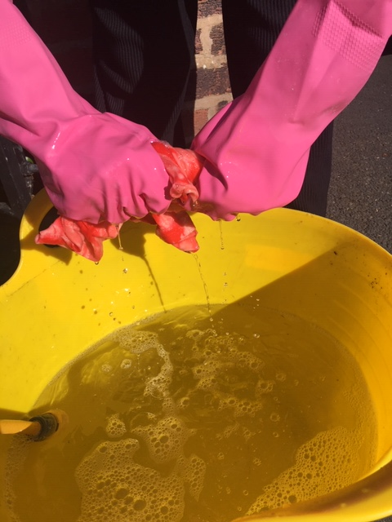
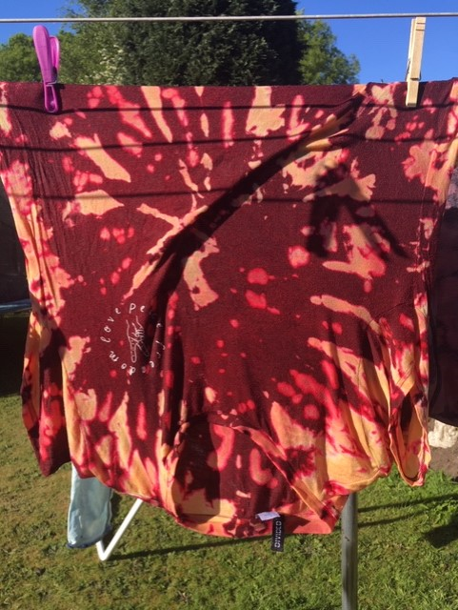
Tie dyeing using Bleach – you can try this at home but please get permission before you do it and DO NOT try it in the house, you must go outside. It is really fun but please be very careful and tell your family in advance that you are doing it.
Put on OLD clothes to do this as if you get Bleach on your clothes it will remove the colour and may ruin good clothes.
Equipment
Rubber gloves
T-shirt
Jeans or anything similar
Bottle of Bleach
Bucket for cold water
Washing line
1. Choose a coloured
t-shirt that you would like to bleach tie dye. 100% cotton will work best.
5.Leave for about 15 mins until it looks right.
3. Put on rubber gloves to protect your hands. Carefully apply the bleach using lines up and down and side to side on your t-shirts. DO NOT get the bleach on your own clothes as it will REMOVE the colour.
4. As you apply the bleach you will see it remove the colour – it looks ace. It’s like magic!!!!
6. Hold it up to see what the results are.
2. Go outside onto the pavement and swirl your t-shirt using your hand to twirl as in picture. This will create the pattern of your tie dye.
11. Once dry you can rinse again and then you must machine wash to make sure all bleach is removed. Make sure you Machine wash as this will stop the bleach from deteriorating your clothes.
7. If you are bleaching jeans, lay them out on the pavement an choose a leg to bleach.
8. Apply the bleach liberally to one side. Use a sponge to rub the bleach in and cover the whole leg.
9. Leave the jeans with the bleach on to dry in the sun. You will see the colour change after about 20 mins.
10. Wash all clothes thoroughly in cold water, rinsing away all bleach. Wring out clothes and hang on the washing line to dry.

