Slide 1
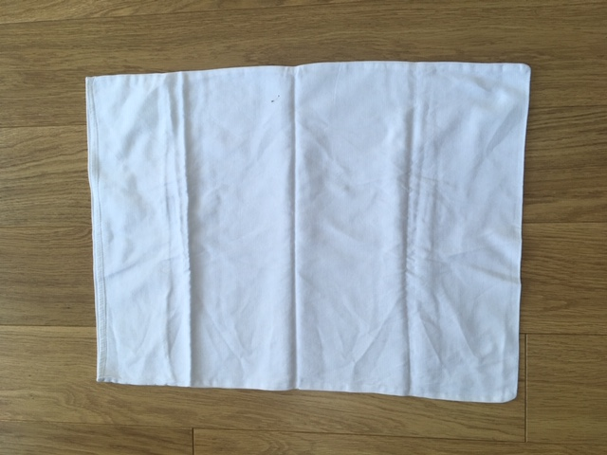
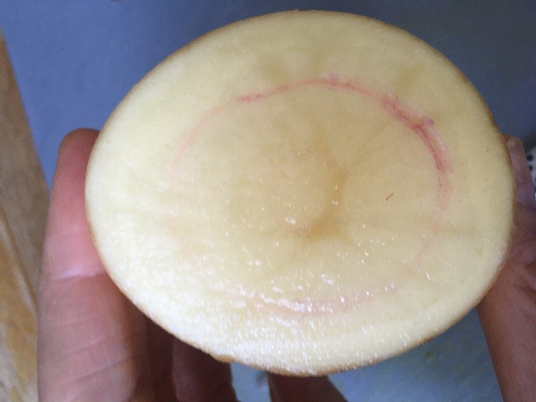
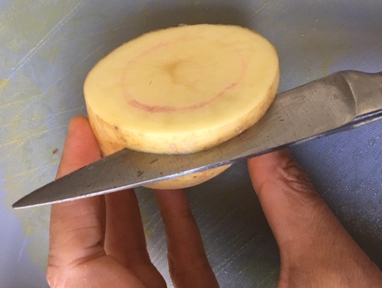
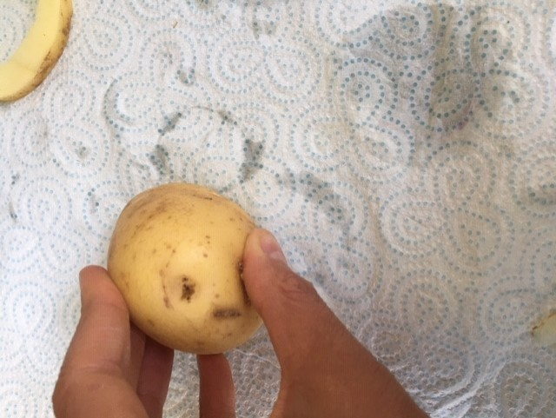
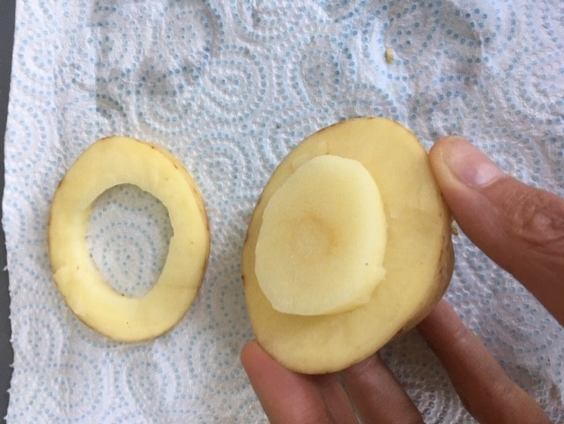
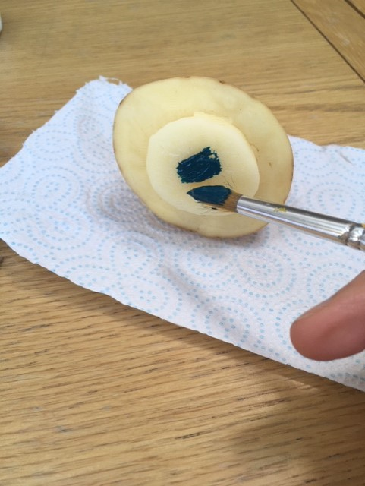
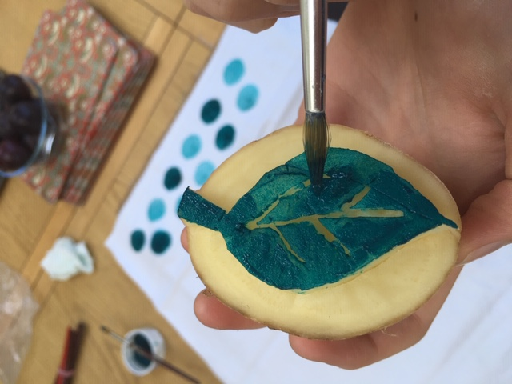
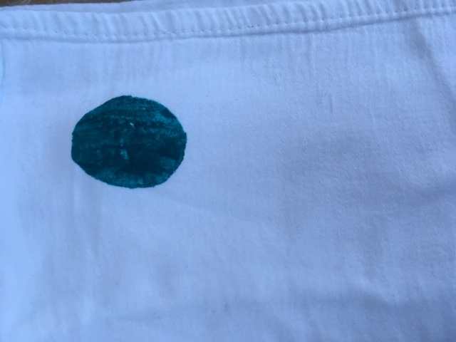
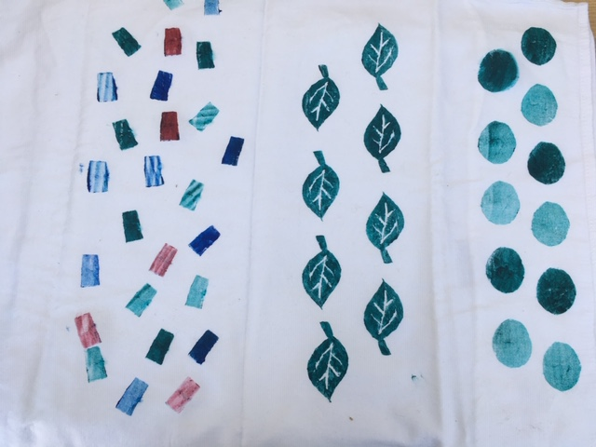
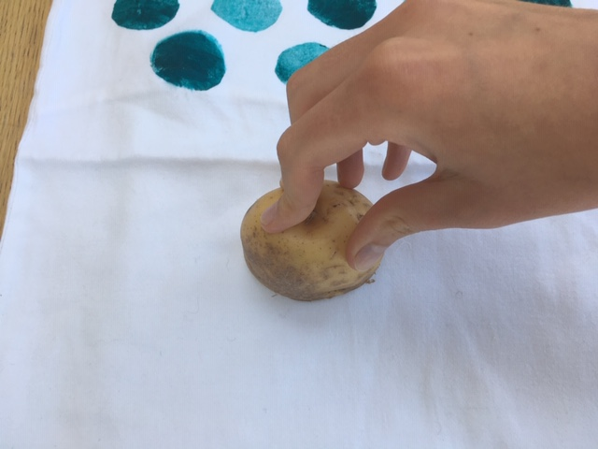
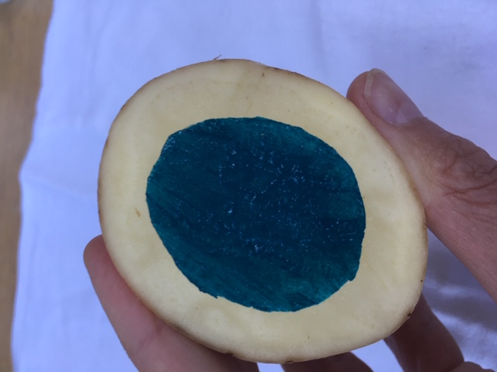
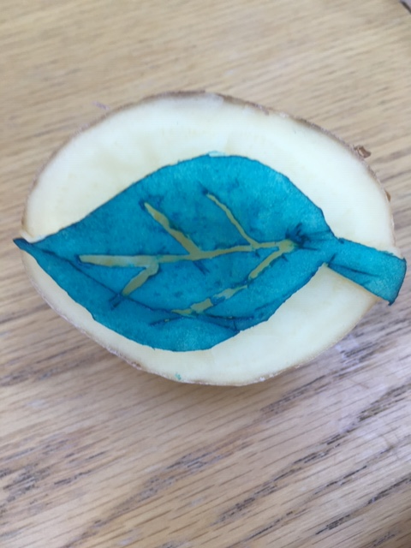
Equipment: pillowcase, potato, sharp knife, pen, paint, paintbrush.
Task - Potato Block Printing at home!
3. Using a pen try and draw on a faint outline of the shape you want to print. Choose a basic shape as detailed ones are tricky to achieve. We choose a circle and a leaf print – see below.
1. Choose a pillow case or white/cream fabric.
2. Select a potato, quite a big one works best!
4. Use a sharp knife to cut out to the shape you want. The shape must be sticking up to print well.
5. Blot any excess moisture from the potato onto kitchen roll. You want your potato to be as dry as possible when printing.
7. Print directly onto your fabric. You may get more than one print before applying more paint but it will fade so if you want each print to be the same, wipe off excess paint and apply again and print.
You can play around with colour schemes and patterns.
8. Repeat and build up different patterns using different shapes and colours.
Leave to dry for 1 hour.
Well done you have successfully created your own unique BLOCK PRINT.
6. Paint a colour onto your raised surface on your potato. Acrylic paint works best but any paint will do. Make it smooth and once applied you will need to print quickly onto your fabric to get the best results.

Slide 2
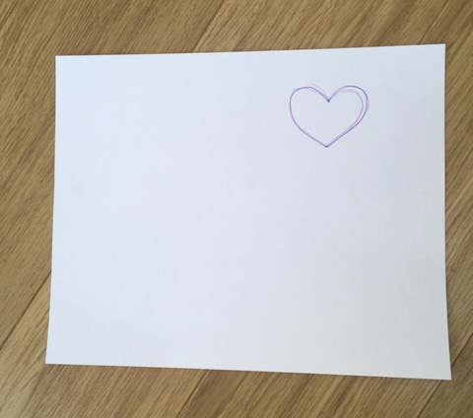
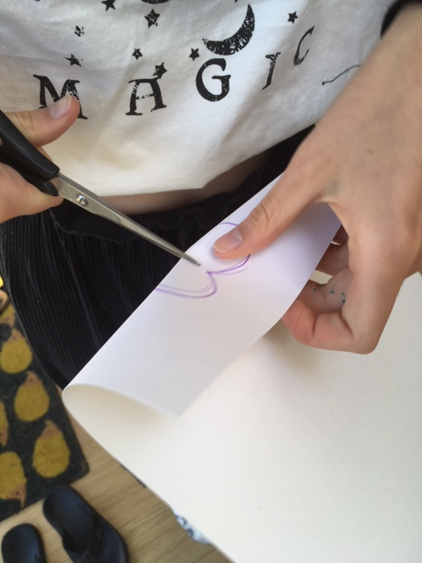
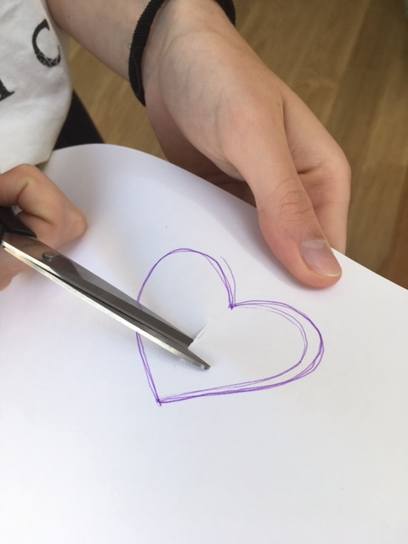
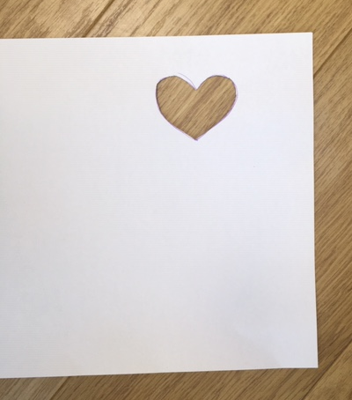
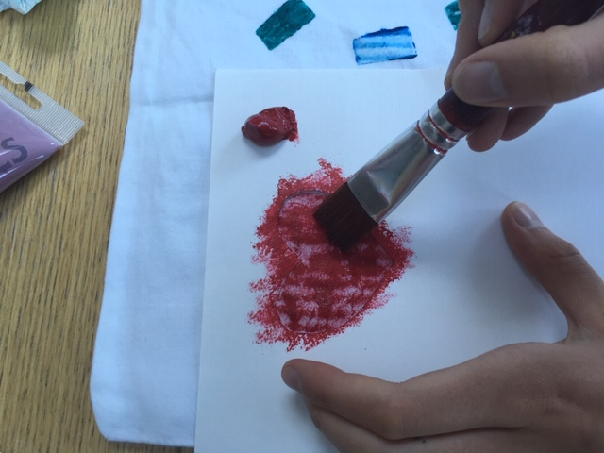
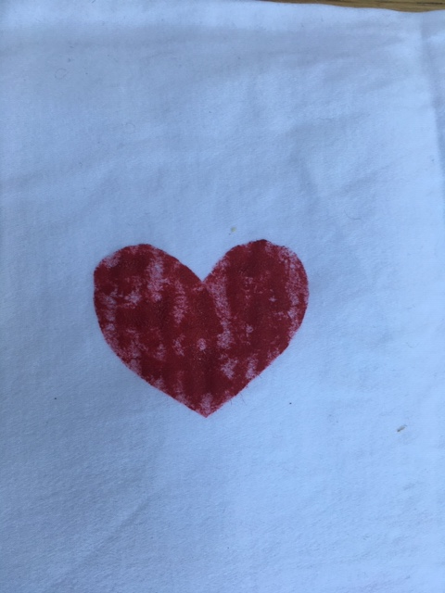
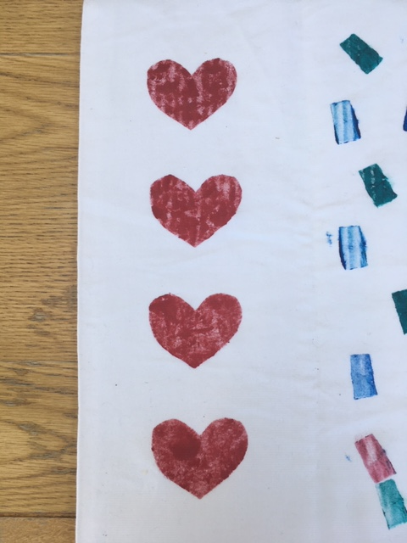
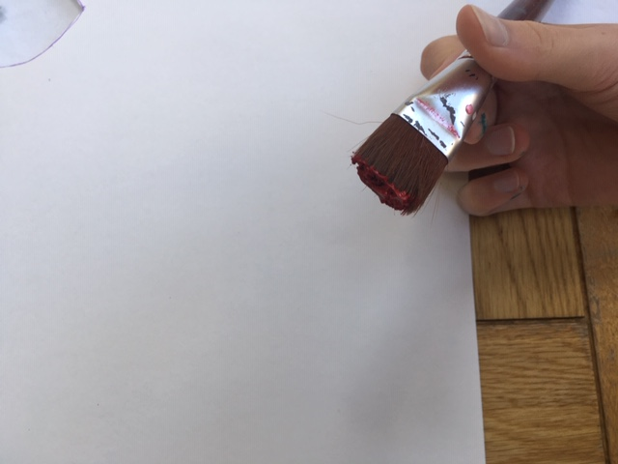
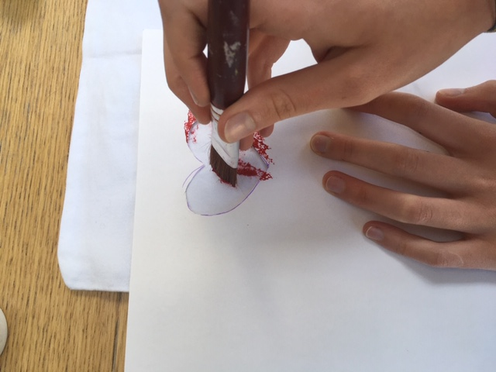
Task - Stencil Printing at home!
Equipment
Paper/card
Pillow case
Paint
Paint brush
Scissors
pen
1. Choose a piece of card or thick paper. If you only have normal paper that will work too but you may need to be extra careful not to apply too much paint. The paper can be any colour. Now draw a shape that you want to repeat print onto the paper/card.
2. Cut out the shape, take care when using scissors.
3. Your stencil should look something like this one above.
4. Now apply paint to your paint brush.
5. Lay the stencil hole over your fabric/pillow case and dab the paint onto the fabric in the gap to create the shape of your stencil. Keep applying paint until the colour looks right. You may want it more solid and so keep going and add more paint to your paintbrush if necessary.
5. You now have one stencil printed heart/shape. Repeat in a pattern of your choice. Remember to re-apply paint to achieve a deep colour each time. Well done!

Slide 3
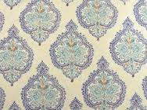
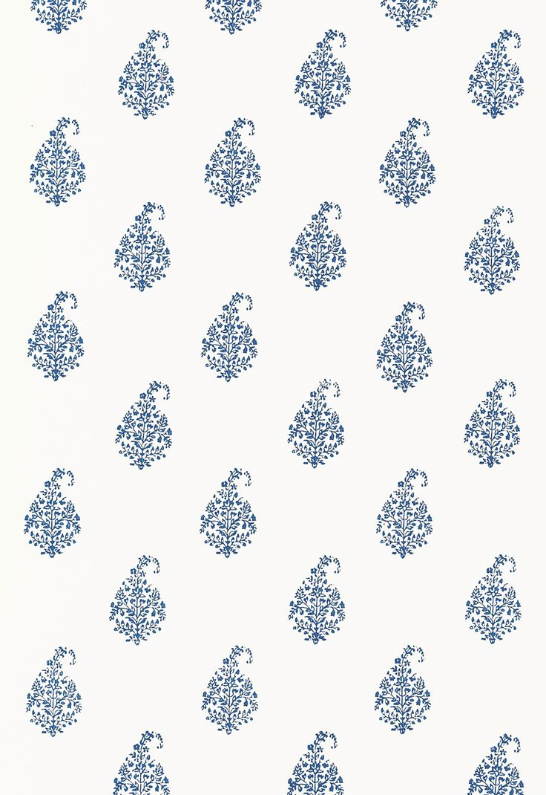
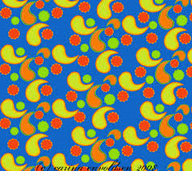
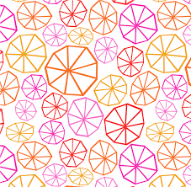
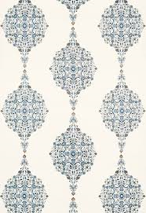
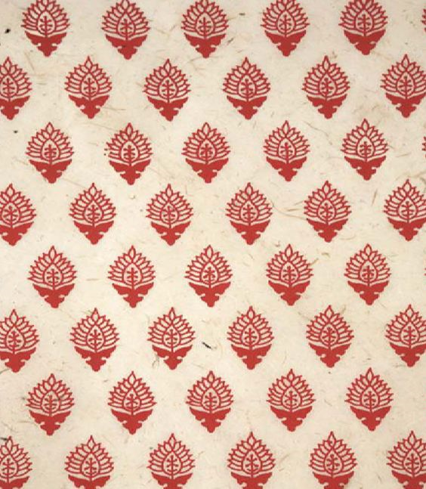
Half drop pattern repeat
Full drop pattern repeat
Random pattern repeat

